Slide 1

Exercise 1 Tracking & Detection
Lecture: Tracking and Detection in Computer Vision by Dr. Slobodan Ilic
Wintersemester 2017/18
Chair for Computer Aided Medical Procedures & Augmented Reality
Technische Universität München
WANG, Pengyuan & GAO, Yingqiang
Student of RCI
14.12.2017

Slide 2
Task description
Given:
- a calibrated camera with its known intrinsic parameter
- a 3D CAD model of the object
- a number of RGB images taken from different perspectives
To solve:
- Estimating the camera pose
- Exploiting the texture information of the object
- Refining the camera pose and minimizing the reprojection error

Slide 3
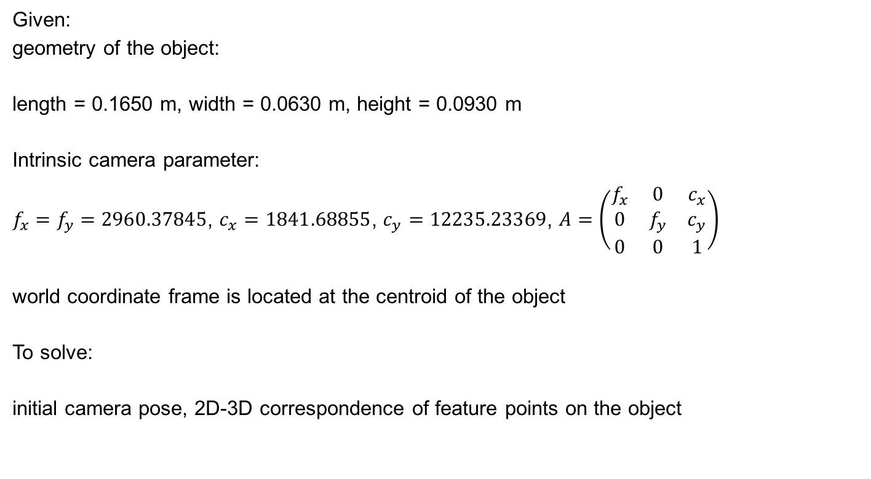
Task 1 model preparation
Given:
geometry of the object:
length = 0.1650 m, width = 0.0630 m, height = 0.0930 m
Intrinsic camera parameter:
$f_{x}=f_{y}=2960.37845$, $c_{x}=1841.68855$, $c_{y}=12235.23369$, $A=\left(\begin{matrix}f_{x} & 0 & c_{x} \\ 0 & f_{y} & c_{y} \\ 0 & 0 & 1\end{matrix}\right)$
world coordinate frame is located at the centroid of the object
To solve:
initial camera pose, 2D-3D correspondence of feature points on the object

Slide 4

Task 1 model preparation
1. 2D-3D alignment of textures on the object
- in the init_texture folder, choose the image DSC_9744.JPG since it contains 3 visible faces
- choose 4 vertices on the object which contains the most visible faces (e.g.A,B,C,F for front face) and capture their image coordinate by calling the MATLAB function ginput()
- Calculate their corresponding world coordinates wo_A, wo_B, wo_C, wo_F
- use PnP algorithm to calculate the initial camera pose by calling the MATLAB function estimateWorldCameraPose()

Slide 5

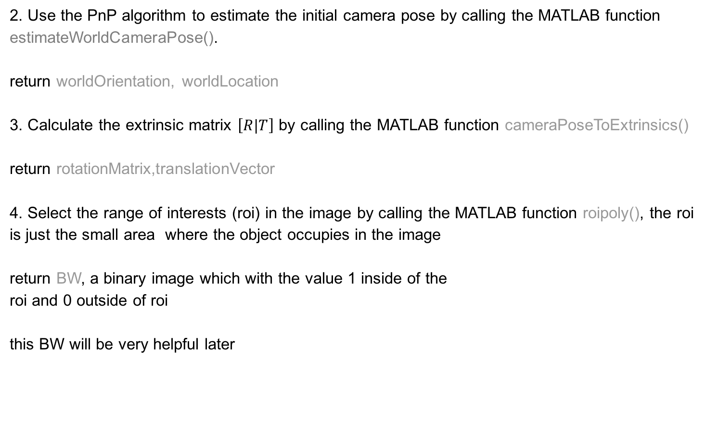
Task 1 model preparation
2. Use the PnP algorithm to estimate the initial camera pose by calling the MATLAB function
estimateWorldCameraPose().
return worldOrientation, worldLocation
3. Calculate the extrinsic matrix $\left[R|T\right]$ by calling the MATLAB function cameraPoseToExtrinsics()
return rotationMatrix,translationVector
4. Select the range of interests (roi) in the image by calling the MATLAB function roipoly(), the roi is just the small area where the object occupies in the image
return BW, a binary image which with the value 1 inside of the
roi and 0 outside of roi
this BW will be very helpful later

Slide 6
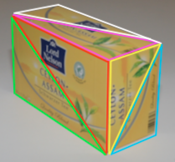
Task 1 model preparation
5. Calculate the sift features on the object, first calculate the features on the entire image, then use BW to filter out those features on the object.
The features can be extracted by calling the function
vl_feat() using VLFEAT library
6. 2D-3D alignment of feature points on the object
- Select the triangle areas which could generate the roi
under the image’s perspective. In this case, the roi could be generated by 6 triangle areas from 3 faces, which are the front face, the right face and the upper face of the object.
- Use the MATLAB function pointsToWorld() and
TriangleRayIntersection() to obtain the 2D-3D correspondentce
of feature points
return INTERSECT, xcoor

Slide 7
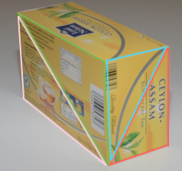
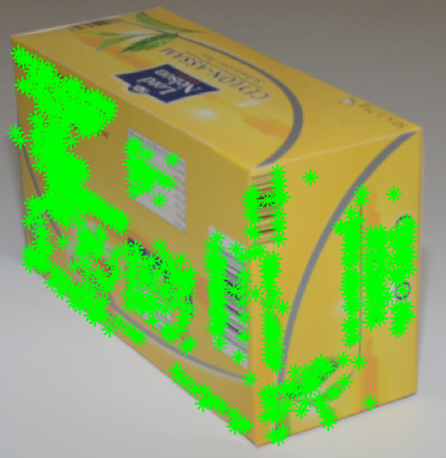
Task 1 model preparation
- INTERSECT is a binary vector which indicates whether the projection of each feature points into 3D is successfully intersected with the triangle, the value will be logical 1 if intersected. We only maintain those 2D features which are successfully projected into the roi and filter their descriptors in desp_i. xcoor represents the world coordinates of the feature points on the object
- Loop over all triangles in order to have all feature points projected into 3D
7. Repeat step 1 to 6 for the image DSC_9748.JPG for the back and left faces. Split this two faces into 4 triangles as projection area in order to obtain the 2D-3D correspondence of the features points on them

Slide 8
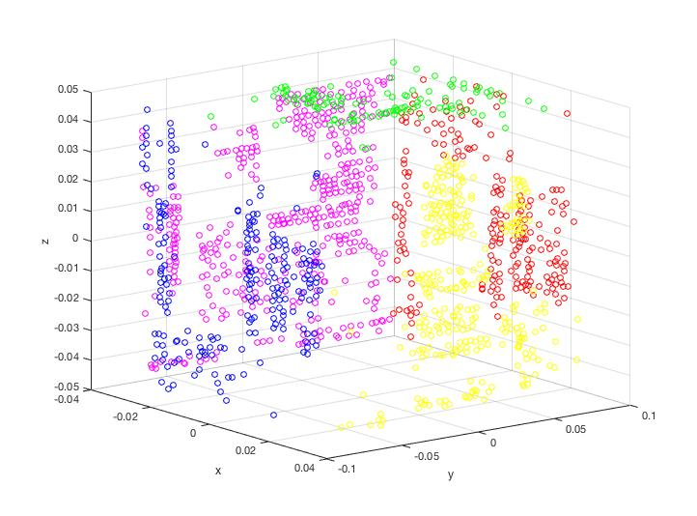
Task 1 model preparation
8. Visualization of all feature points in 3D

Slide 9
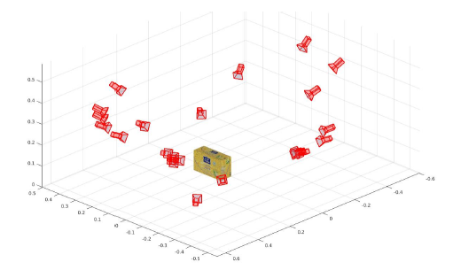
Task 2 pose estimation with PnP
Given:
the 2D-3D correspondence of feature points calculated in the Task 1
To solve:
camera pose estimation with PnP using RANSAC algorithm for all images in detection folder
the output of this task should be the estimated camera poses plotted together

Slide 10
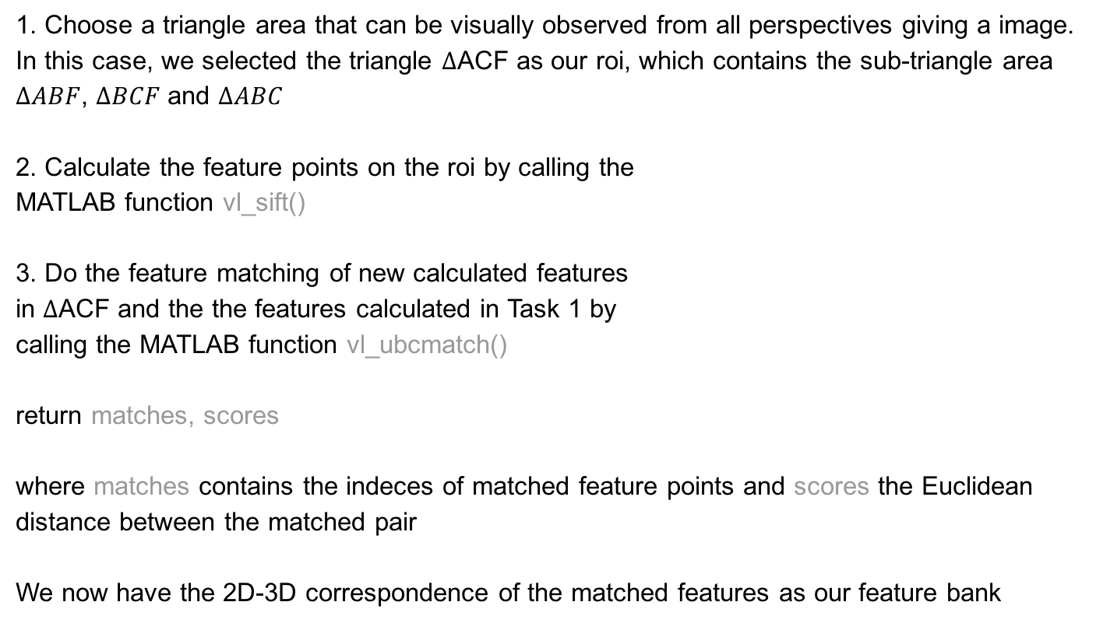
Task 2 pose estimation with PnP
1. Choose a triangle area that can be visually observed from all perspectives giving a image. In this case, we selected the triangle $∆$ACF as our roi, which contains the sub-triangle area $∆ABF$, $∆BCF$ and $∆ABC$
2. Calculate the feature points on the roi by calling the
MATLAB function vl_sift()
3. Do the feature matching of new calculated features
in $∆$ACF and the the features calculated in Task 1 by
calling the MATLAB function vl_ubcmatch()
return matches, scores
where matches contains the indeces of matched feature points and scores the Euclidean distance between the matched pair
We now have the 2D-3D correspondence of the matched features as our feature bank

Slide 11
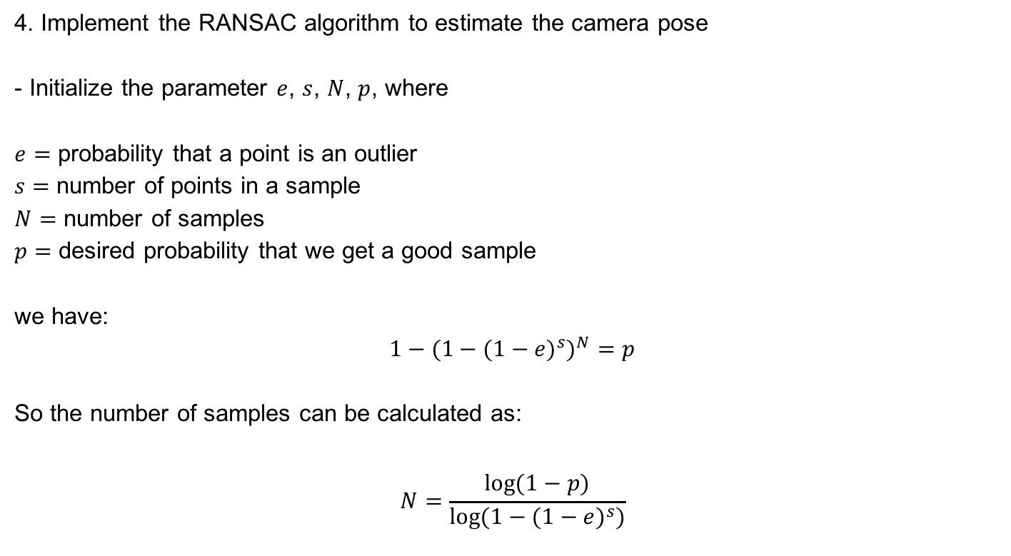
Task 2 pose estimation with PnP
4. Implement the RANSAC algorithm to estimate the camera pose
- Initialize the parameter $e$, $s$, $N$, $p$, where
$e=$ probability that a point is an outlier
$s=$ number of points in a sample
$N=$ number of samples
$p=$ desired probability that we get a good sample
we have:
$$1−{{(1−(1−e)}^{s})}^{N}=p$$
So the number of samples can be calculated as:
$$N=\frac{log⁡(1−p)}{log⁡(1−{(1−e)}^{s})}$$

Slide 12
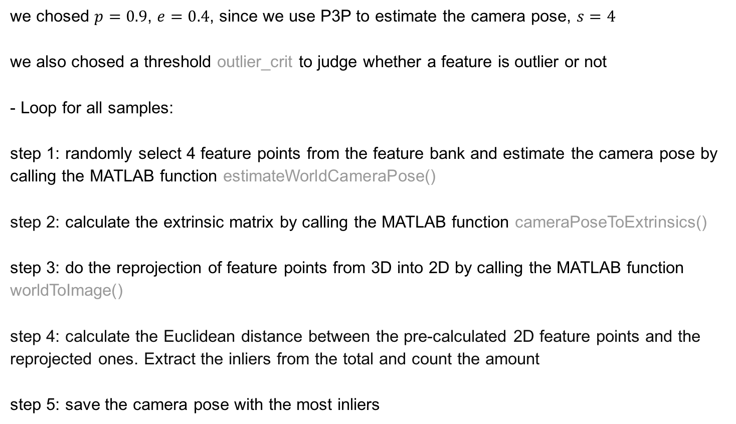
Task 2 pose estimation with PnP
we chosed $p=0.9$, $e=0.4$, since we use P3P to estimate the camera pose, $s=4$
we also chosed a threshold outlier_crit to judge whether a feature is outlier or not
- Loop for all samples:
step 1: randomly select 4 feature points from the feature bank and estimate the camera pose by calling the MATLAB function estimateWorldCameraPose()
step 2: calculate the extrinsic matrix by calling the MATLAB function cameraPoseToExtrinsics()
step 3: do the reprojection of feature points from 3D into 2D by calling the MATLAB function
worldToImage()
step 4: calculate the Euclidean distance between the pre-calculated 2D feature points and the reprojected ones. Extract the inliers from the total and count the amount
step 5: save the camera pose with the most inliers

Slide 13
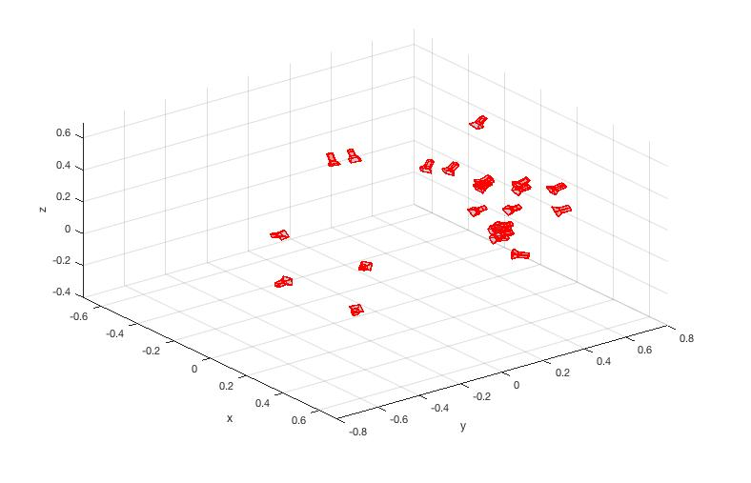
Task 2 pose estimation with PnP
5. Visualization of all estimated camera poses

Slide 14
Task 3 pose refinement with non-linear optimization
Given:
the estimated camera poses from Task 2 and the feature bank
To solve:
refined camera poses using non-linear optimization method
the output of this task is to minimize the reprojection error

Slide 15
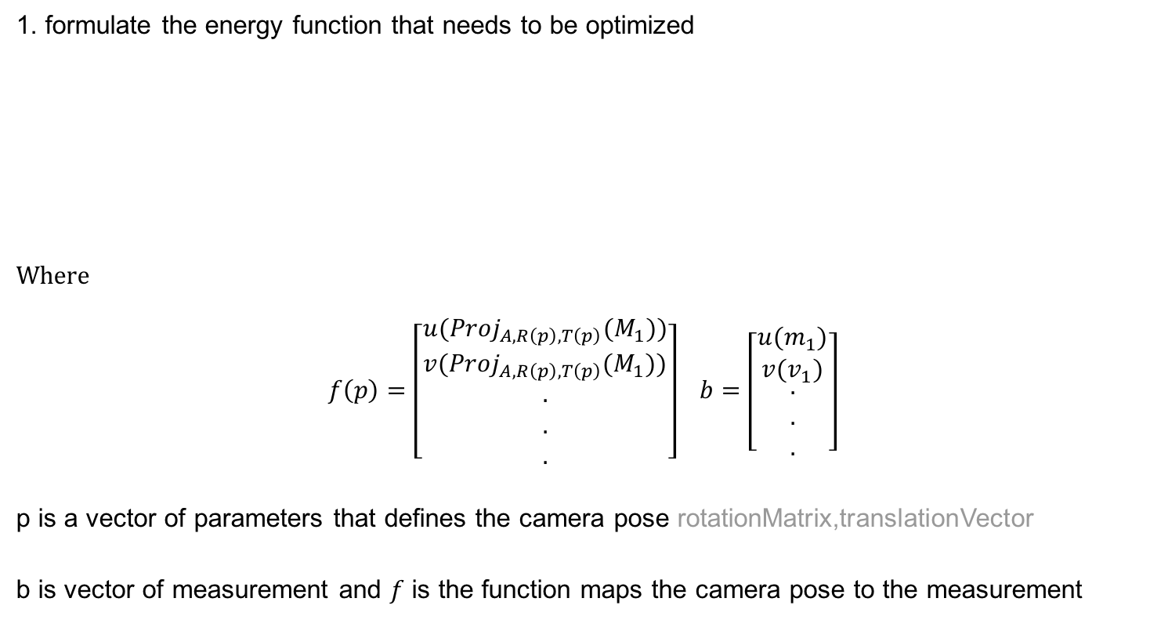
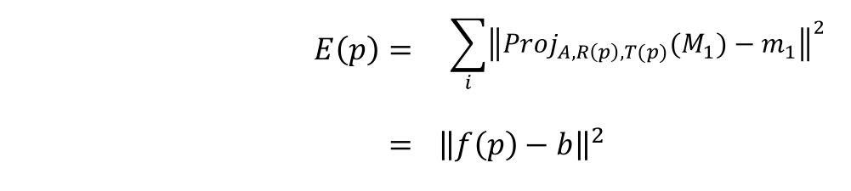
Task 3 pose refinement with non-linear optimization
1. formulate the energy function that needs to be optimized
Where
$f\left(p\right)=\left[\begin{aligned}u({Proj}_{A, R\left(p\right), T\left(p\right)}(M_{1})) \\ v({Proj}_{A, R\left(p\right), T\left(p\right)}(M_{1})) \\ . \\ . \\ .\end{aligned}\right]$ $b=\left[\begin{aligned}\begin{aligned}u(m_{1}) \\ v(v_{1})\end{aligned} \\ . \\ . \\ .\end{aligned}\right]$
p is a vector of parameters that defines the camera pose rotationMatrix,translationVector
b is vector of measurement and $f$ is the function maps the camera pose to the measurement
$$E\left(p\right)=$$ | $$\sum_{i}{{\left\|{Proj}_{A, R\left(p\right), T(p)}{(M}_{1})−m_{1}\right\|}^{2}}$$
$$=$$ | $${\left\|f\left(p\right)−b\right\|}^{2}$$

Slide 16
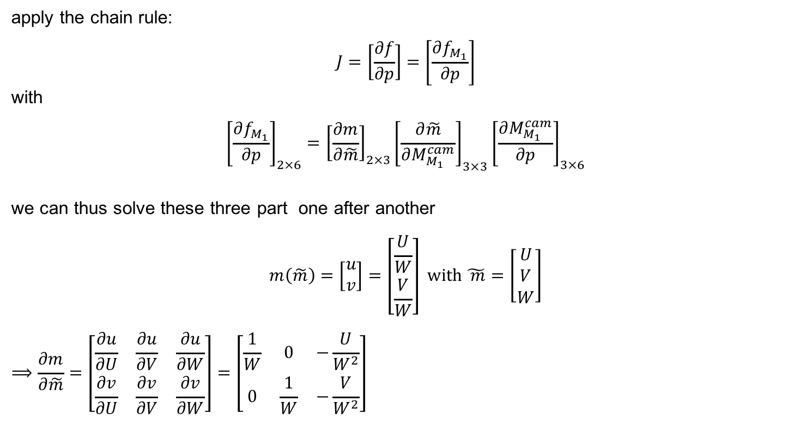
Task 3 pose refinement with non-linear optimization
apply the chain rule:
$$J=\left[\frac{∂f}{∂p}\right]=\left[\frac{∂f_{M_{1}}}{∂p}\right]$$
with
$${\left[\frac{∂f_{M_{1}}}{∂p}\right]}_{2×6}={\left[\frac{∂m}{∂\tilde{m}}\right]}_{2×3}{\left[\frac{∂\tilde{m}}{∂M_{M_{1}}^{cam}}\right]}_{3×3}{\left[\frac{∂M_{M_{1}}^{cam}}{∂p}\right]}_{3×6}$$
we can thus solve these three part one after another
$$m\left(\tilde{m}\right)=\left[\begin{aligned}u \\ v\end{aligned}\right]=\left[\begin{aligned}\frac{U}{W} \\ \frac{V}{W}\end{aligned}\right] with \tilde{ m}=\left[\begin{aligned}U \\ V \\ W\end{aligned}\right]$$
$$⟹\frac{∂m}{∂\tilde{m}}=\left[\begin{matrix}\frac{∂u}{∂U} & \frac{∂u}{∂V} & \frac{∂u}{∂W} \\ \frac{∂v}{∂U} & \frac{∂v}{∂V} & \frac{∂v}{∂W}\end{matrix}\right]=\left[\begin{matrix}\frac{1}{W} & 0 & −\frac{U}{W^{2}} \\ 0 & \frac{1}{W} & −\frac{V}{W^{2}}\end{matrix}\right]$$

Slide 17
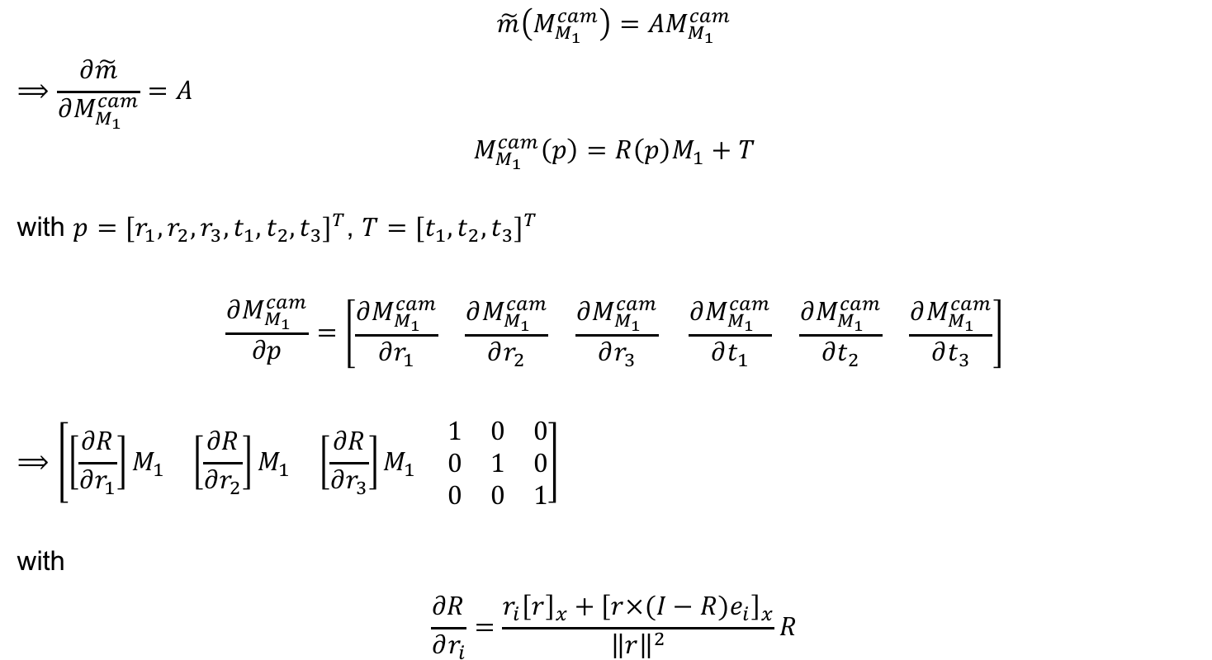
Task 3 pose refinement with non-linear optimization
$$\tilde{m}\left(M_{M_{1}}^{cam}\right)=AM_{M_{1}}^{cam}$$
$$⟹\frac{∂\tilde{m}}{∂M_{M_{1}}^{cam}}=A$$
$$M_{M_{1}}^{cam}\left(p\right)=R\left(p\right)M_{1}+T$$
with $p={[r_{1},r_{2},r_{3},t_{1},t_{2},t_{3}]}^{T}$, $T={[t_{1},t_{2},t_{3}]}^{T}$
$$\frac{∂M_{M_{1}}^{cam}}{∂p}=\left[\begin{matrix}\frac{∂M_{M_{1}}^{cam}}{∂r_{1}} & \frac{∂M_{M_{1}}^{cam}}{∂r_{2}} & \frac{∂M_{M_{1}}^{cam}}{∂r_{3}}\end{matrix} \begin{matrix}\frac{∂M_{M_{1}}^{cam}}{∂t_{1}} & \frac{∂M_{M_{1}}^{cam}}{∂t_{2}} & \frac{∂M_{M_{1}}^{cam}}{∂t_{3}}\end{matrix}\right]$$
$$⟹\left[\begin{matrix}\left[\frac{∂R}{∂r_{1}}\right]M_{1} & \left[\frac{∂R}{∂r_{2}}\right]M_{1} & \left[\frac{∂R}{∂r_{3}}\right]M_{1}\end{matrix} \begin{matrix}1 & 0 & 0 \\ 0 & 1 & 0 \\ 0 & 0 & 1\end{matrix}\right]$$
with
$$\frac{∂R}{∂r_{i}}=\frac{r_{i}{\left[r\right]}_{x}+{\left[r×(I−R)e_{i}\right]}_{x}}{{\left\|r\right\|}^{2}}R$$

Slide 18
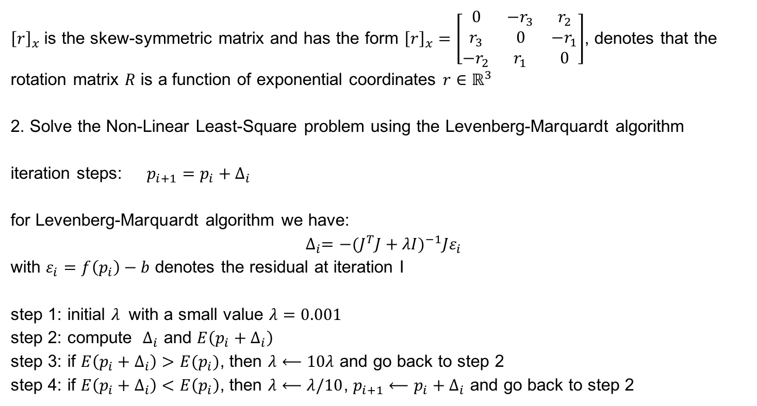
Task 3 pose refinement with non-linear optimization
${\left[r\right]}_{x}$ is the skew-symmetric matrix and has the form ${\left[r\right]}_{x}=\left[\begin{matrix}0 & −r_{3} & r_{2} \\ r_{3} & 0 & −r_{1} \\ −r_{2} & r_{1} & 0\end{matrix}\right]$, denotes that the rotation matrix $R$ is a function of exponential coordinates $r∈ℝ^{3}$
2. Solve the Non-Linear Least-Square problem using the Levenberg-Marquardt algorithm
iteration steps: $p_{i+1}=p_{i}+∆_{i}$
for Levenberg-Marquardt algorithm we have:
$$∆_{i}=−{(J^{T}J+λI)}^{−1}Jε_{i}$$
with $ε_{i}=f\left(p_{i}\right)−b$ denotes the residual at iteration I
step 1: initial $λ$ with a small value $λ=0.001$
step 2: compute $∆_{i}$ and $E\left(p_{i}+∆_{i}\right)$
step 3: if $E\left(p_{i}+∆_{i}\right)>E(p_{i})$, then $λ⟵10λ$ and go back to step 2
step 4: if $E\left(p_{i}+∆_{i}\right)<E\left(p_{i}\right)$, then $λ⟵λ/10$, $p_{i+1}⟵p_{i}+∆_{i}$ and go back to step 2

Slide 19
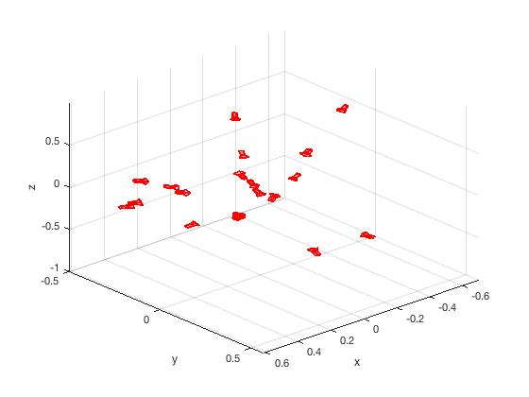
Task 3 pose refinement with non-linear optimization
Before pose refinement
After pose refinement

Slide 20
Exercise 1 Tracking & Detection
Thanks for your attention!

